Slide 1

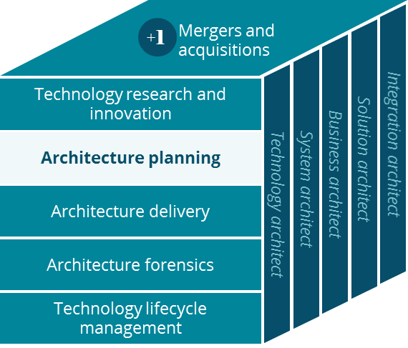
Commercial- Individuals Business Canvas
Architecture Planning
Grace Lee
Peter Cram
1/2020

Slide 2
Business Canvas
Individual Consumer : Commercial
Sales / Service / Delivery
Key Partnerships
Key Activities
Value Proposition
Customer Relationships
Customer Segment
Clearing House
PBM
Prospect Customers
Manage Account
Member Admin
Manage Network
Better & Easy Service
Brokers
Clinical professionals
Providers
Individuals Consumers
Deliver Service
Contract & Pay Providers
Lower Member Cost
Customer Care
Brokers
Hospitals
Regulatory Compliance & Reporting
Brand Recognition
ACO
Vendors
Channels
Key Resources
Quality of Service *
Digital
(Aetna Health)
Mail
TPA
States
Local Presence
CVS / Aetna Brand
Digital Assets
Vendor Portals
Face to face
Local Community
Auxiliary Product Outsource
Digital Platform
Data & Insights
Local Presence
Phone, Fax, Emails
Video (TeleDoc)
IT Platform
Customer Care
Minute Clinic
HealthHub
Preventative Health Care
Wellness & Care Management *
Exchanges
Enhanced Direct Enroll
Cost Structure
Revenue Streams
Marketing & Sales via local agents
Operational Costs
Research & Development
General & Administrative Costs
Premium
Health risk-adjustment
payments
Long Term Investment
Medical Cost
Vendor Partner Care & Wellness
Notes:
Strong Relationship between brokers (local agents – proxy : strong incentive, high commission first year) and customers (members) because of locally strongly connected… No sales agents, only customer cares, renew,
Very strong relationship between Aetna sales and customers
Affordable Act – remove the sales agents…
Very price sensitive, very competitive space, brand recognition (because of large account) in local market (better local relationships) is important when price is the same,
For prospect, national account will have positive impacts… after on-boarding, local presence and good rates are the keys to keep the account.
Very narrow market for individuals… Amazon and Google : go between (marketplace), regulations and audits (too risky), Insurance & PBM (CareMark/CVS/Aetna), Amazon & Walmart – owned distribution centers

Slide 3
Glossary
Glossary | Description
Clinical professional | Pharmacists, nurse practitioners, community liaisons and social works
IPA | Individual Partitional Association
ASO | Administrative Services Only
ACO | Accountable Care Org
Stop-loss insurance | Aetna provides stop-loss insurance for national account and middle market ASO. Stop-loss insurance is based on cash flow monthly for claims.
AFA | Aetna Funding Advantage for small group
ACC | Aetna Community Care. Face to Face = Minute Clinic, Pharmacy, ACC
TPA | Third Party Administrator
Providers | Providers, Hospitals, Clinical Professionals
Auxiliary Product Outsource | Vision and Dental Partnerships for Care and Wellness
Value Proposition | Based on Better Service, Easy Service, and Lower Cost

